Slide 1
WEBPAGE classification for safer browsing
Abhay Pratap Singh - 1900320120002
Aniket Kumar Singh - 1900320120009
Gangadhar Kannaujiya - 19003201200017
Guide-Mr. B P Sharma.
Department- Computer Science and Engineering
ABES Engineering College, Ghaziabad
*Affiliated to Dr. A.P.J. Abdul Kalam Technical University, Uttar Pradesh, Lucknow

Slide 2


*Problem Statement :-
Phishing is the fraudulent attempt to obtain sensitive information or data, such as usernames, passwords and credit card details, by disguising oneself as a trustworthy entity in an electronic communication.
“The web browser is one of the most heavily used programs on a computer or mobile device today. Because of its ubiquitous nature, it is also an extremely popular target for attackers”.
Attackers typically target the web browser to either hijack or snoop on the web traffic from it.
By way of people increasingly depend on internet for personal finance , business, investment . Internet fraud becomes a large threat. Through attractive websites and offers on Internet people want to take benefit and for this people share confidential data with the attacker.
So, it is necessary to identify fake websites for end user’s security. Once the user visits the website, attacker can fetch the confidential information of the user.

Slide 3

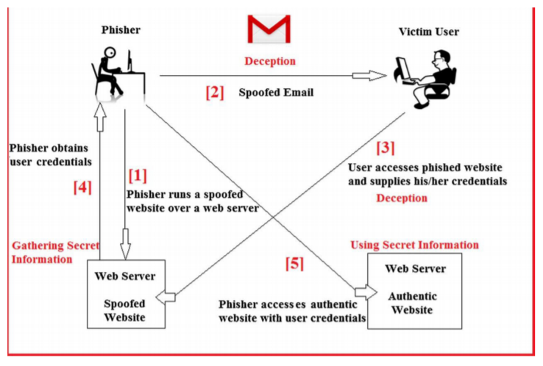

*Background of web phishing detection-

Slide 4

*Tips for Safe Web Browsing:-
Strong passwords-
A strong password is the equivalent of a deadbolt on a door. The more difficult it is to gain entrance to your accounts, the safer your accounts are.
Use a firewall-
A firewall is an application that protects your computer from hackers gaining unauthorized access to your computer. Setting up a personal firewall will dramatically reduce the possibility of your computer being attacked by Internet threats.
Regularly update your Security software-
You must install each update as it is made available. Cyber criminals are constantly finding new ways to infiltrate systems and launch new threats, and security software developers release updates to combat this trend.
Be wary of clicking links in email or instant messages.
Viruses spread easily through links in instant messages and email attachments. Even if you know and trust the person who sent it, it’s possible the link is infected and the sender is unaware of it.

Slide 5
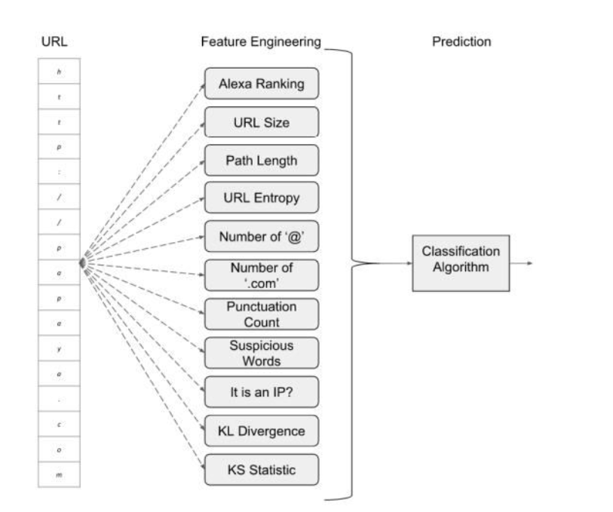
Approach
URLs (user input)
Features Extraction
Output – Classified URLs
Result

Slide 6

*Feature-engineering approaches for classifying phishing URLs – Phishing URL detection can be done via proactive or reactive means. This type of services exposes a blacklist of malicious URLs to be queried. Blacklists are constructed by using different techniques, including manual reporting, honeypots, or by crawling the web in search of known phishing characteristics.

Slide 7
Technologies Used
Front-End
HTML
CSS
Back-End
Java Script
NodeJs

Slide 8

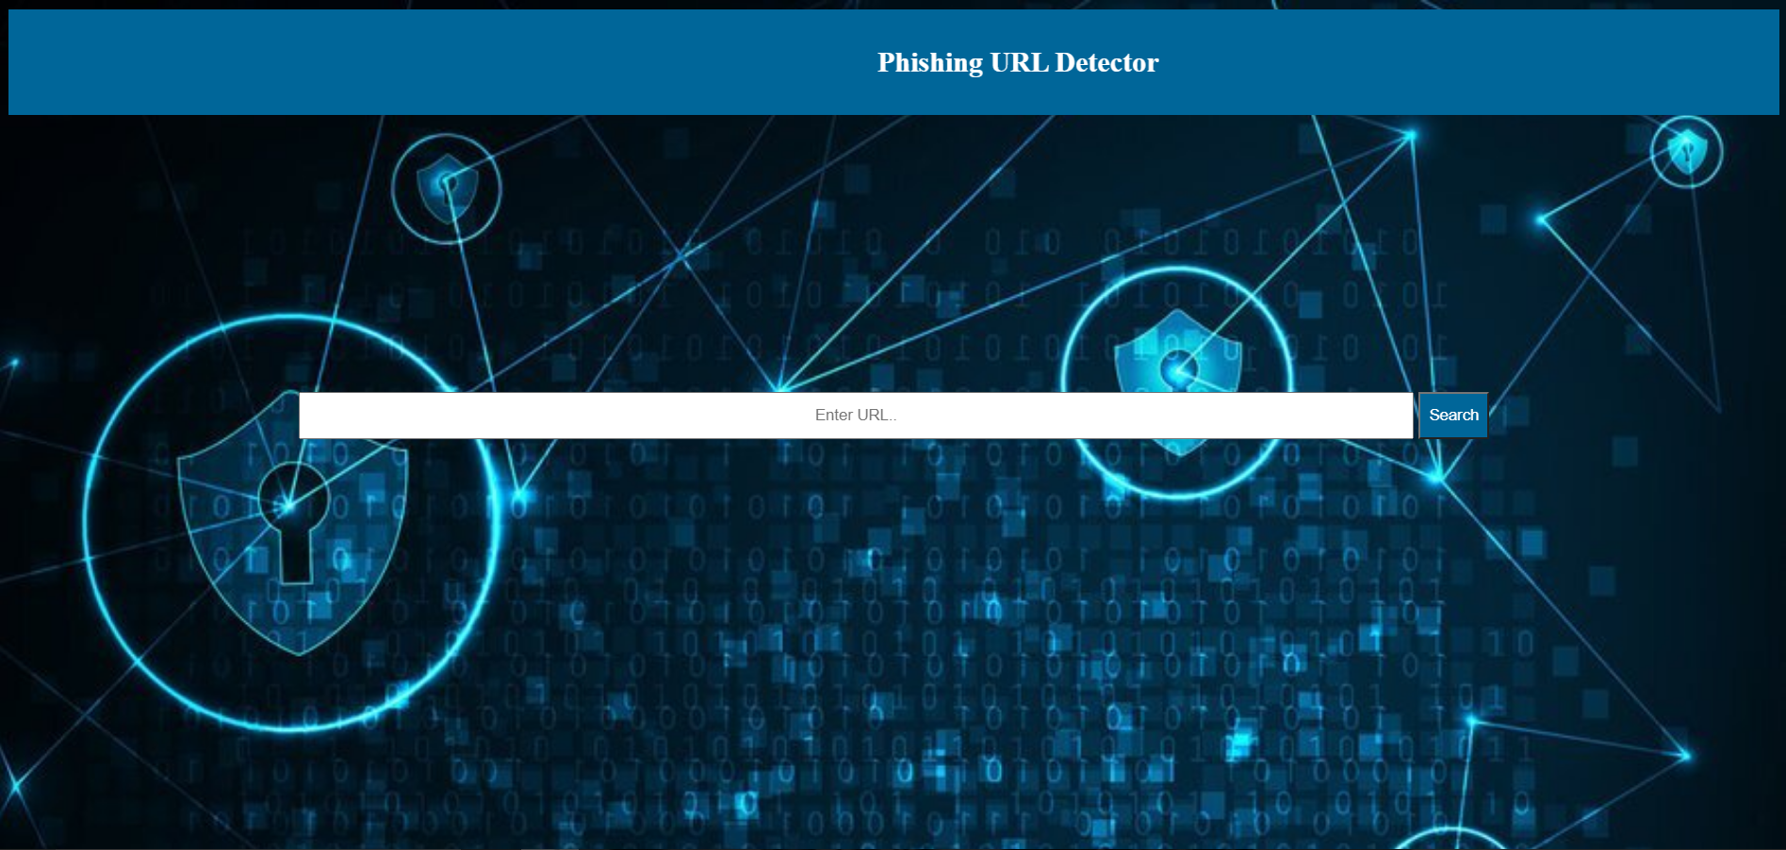
Frontend of our Project

Slide 9
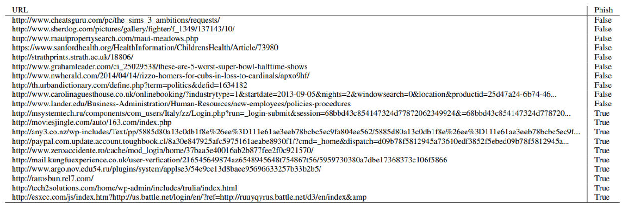
Some examples of classifying phishing URL’S

Slide 10



